Slide 1
Results
Temperature
Humidity
Ph
Rainfall

Slide 2
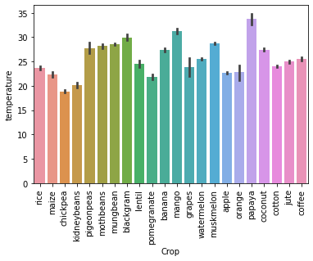
Results
Temperature

Slide 3
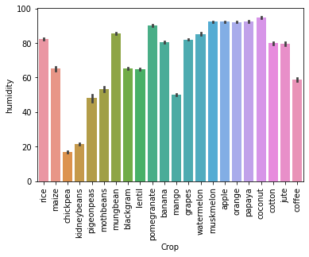
Results
Humidity

Slide 4
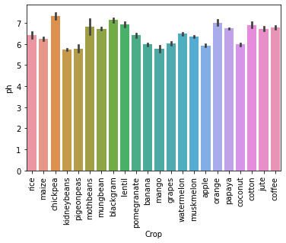
Results
Ph

Slide 5
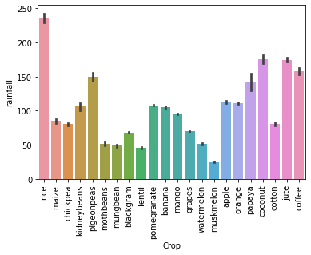
Results
Rainfall

